Slide 1
Welfare assessment of Skopelos goats under intensive and extensive farming systems
Gelasakis A.I.¹, Korelidou V.¹, Kalogianni A.I.¹, Basdagianni Z.², Arsenos G.³, Giusti A.⁴, Bossis I.²
Department of Animal Science, School of Animal Biosciences, Agricultural University of Athens (AUA), Iera Odos 75 str., 11855 Athens, Greece
Department of Agricultural Sciences, School of Agriculture, Forestry and Natural Resources, University Campus, Aristotle University of Thessaloniki (AUTh), 54124 Thessaloniki, Greece
School of Veterinary Medicine, Faculty of Health Sciences, University Campus, Aristotle University of Thessaloniki (AUTh), 54124 Thessaloniki, Greece
Cyprus Research & Innovation Center (Cyric), 72, 28th Octovriou Avenue, Office 301, Engomi, 2414 Nicosia, Cyprus

Slide 2
Introduction
Intensive farming systems are accused of downgrading animal welfare
Welfare improvement → ↑ living quality, sustainability, profitability
Extensive farming systems are challenged by environmental conditions and diseases

Slide 3
Introduction
The objective of this prospective study was to use animal-based indicators to assess health and welfare of the goats raised either on intensive or extensive systems.

Slide 4
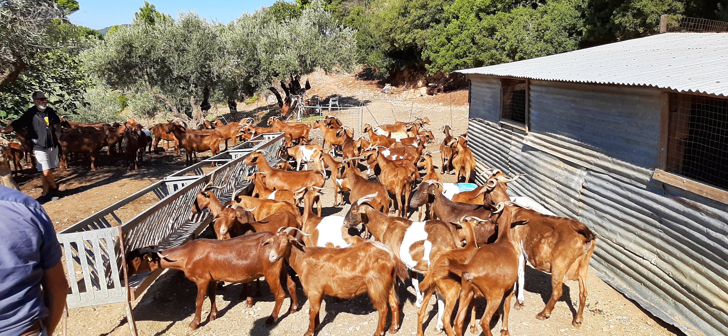
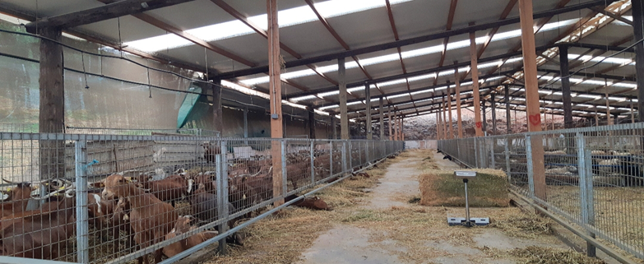
Materials and Methods
Adult Skopelos goats
100 intensively reared (Attika region)
133 extensively reared (Skopelos island)
The study began post-weaning and 4 samplings were carried out every 45-50 days
Assessments were carried out after the morning milking by the same veterinarian

Slide 5
Materials and Methods
Modified AWIN Protocol
Limbs
Head
Udder
Body
Lameness
Overgrown hooves
Arthritis
Anaemia
Eye discharge
Teeth problems
Skin lesions
Mastitis
Abscesses
Papillomatosis
Fibrosis
Asymmetry
Supramammary lymph nodes (1-5)
Abscesses
Hair coat quality
Faecal soiling
Lymph nodes (1-5)
- Submandibular
- Prescapular
- Prefemoral

Slide 6
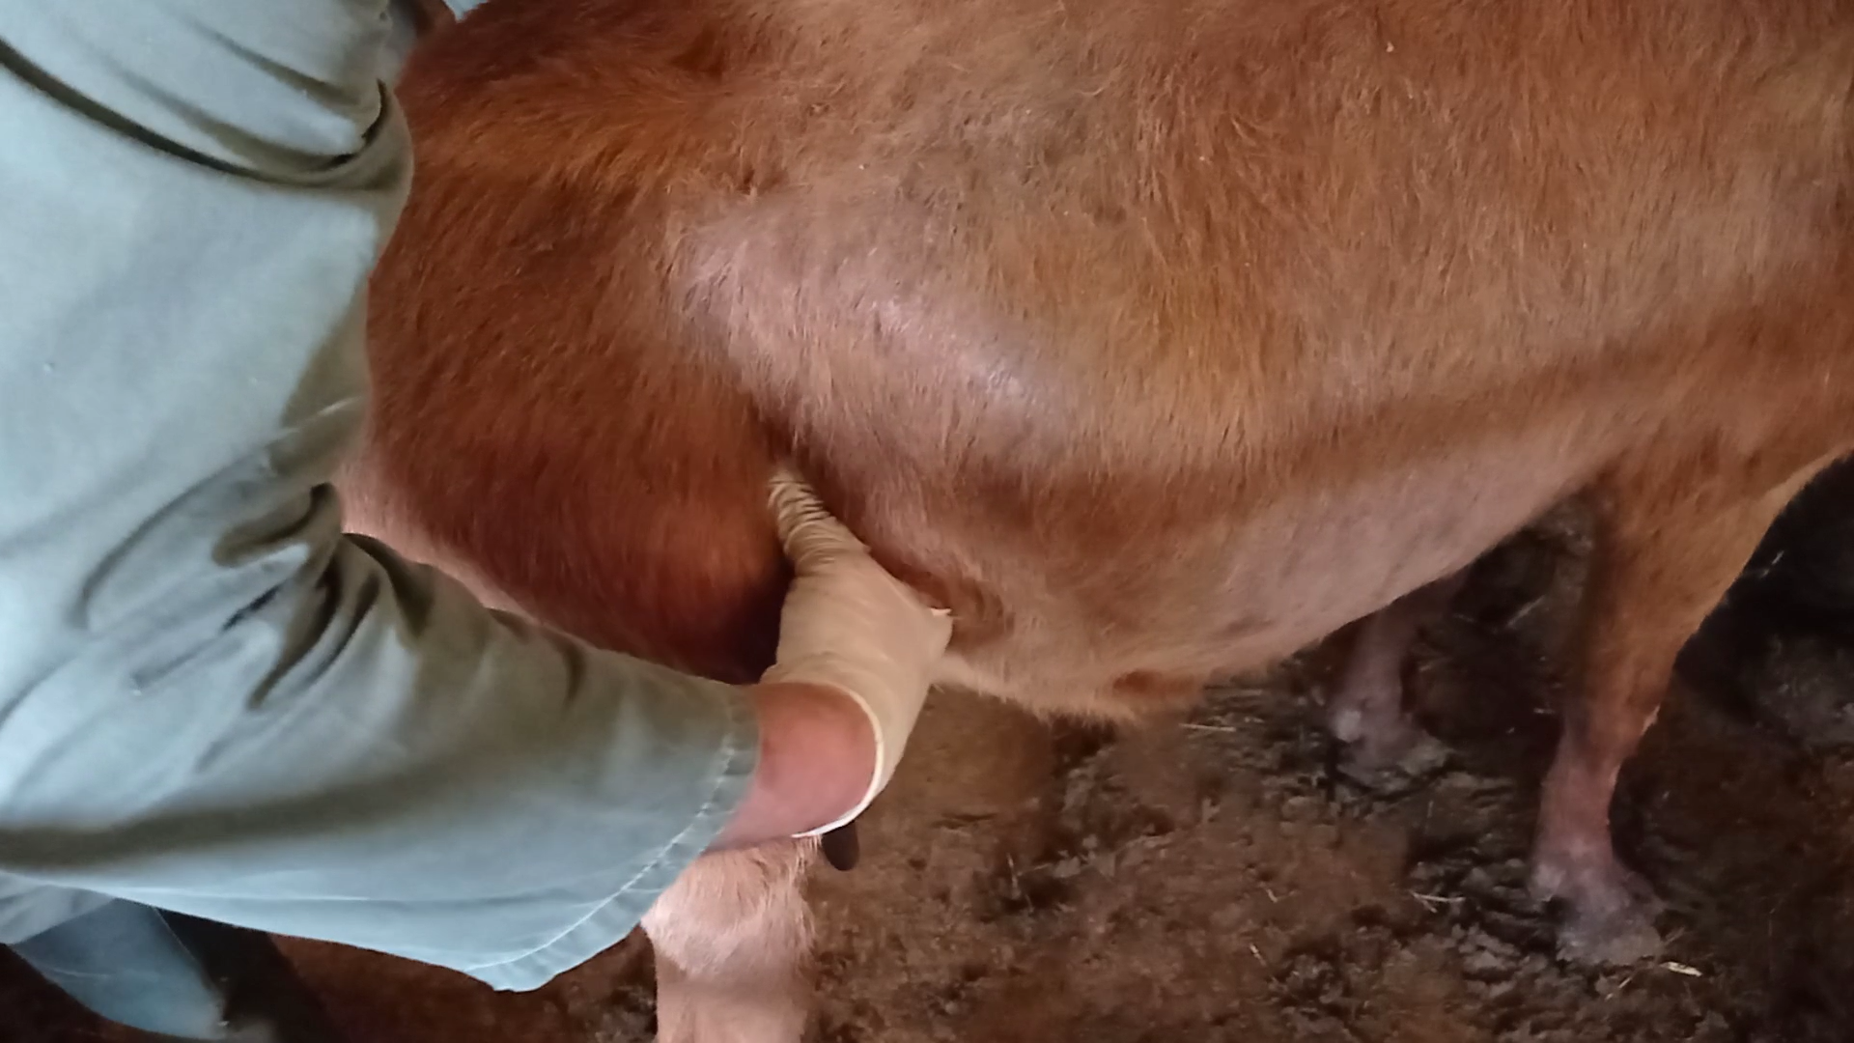
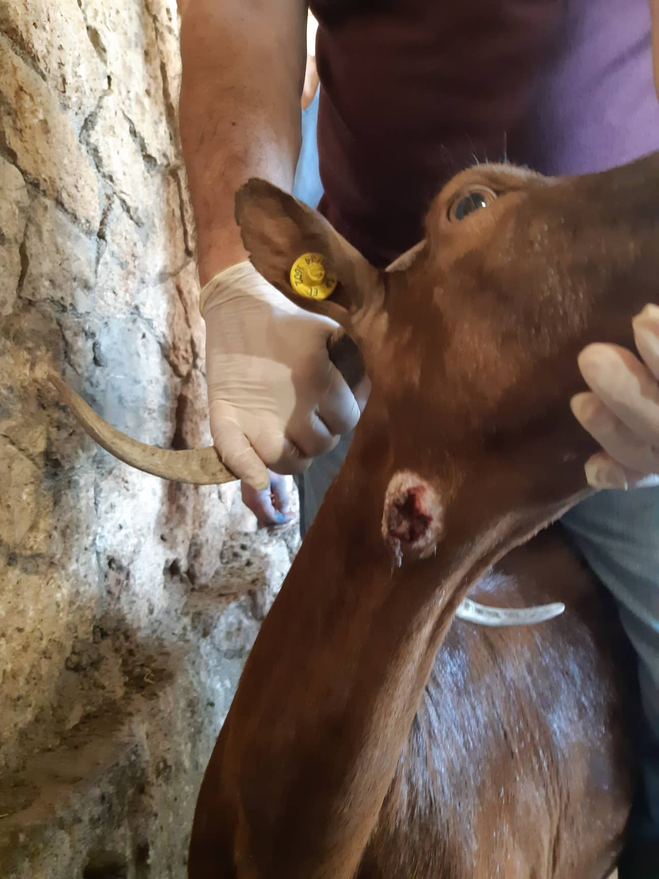
Materials and Methods
Udder asymmetry
Prefemoral lymph node palpation
Burst abscess

Slide 7
Materials and Methods
Point Prevalence
Mixed binary regression (SPSS v.26)
Fixed effects = Age (2,3, ≥4), Farm (1-2), Stage of milking period (1-4), Milk yield (kg)
Random effect = Animal
Data analysis
Chi-square
(comparison of the prevalence of different health indicators between intensively and extensively reared animals for each sampling)

Slide 8
Results – Farm effect
Traits | F-value | P-value (0.05)
Lameness | 4.7 | 0.030
Arthritis | 2.9 | 0.088
Overgrown hooves | 31.0 | 0.000
Anaemia | 18.7 | 0.000
Nose lesions | 0.0 | 0.897
Gingivitis | 10.3 | 0.001
Udder abscesses | 1.4 | 0.245
Papillomatosis | 2.9 | 0.088
Fibrosis | 2.5 | 0.115
Asymmetry | 0.0 | 0.888
R supramammary lymph node | 3.3 | 0.069
L supramammary lymph node | 3.6 | 0.059
Faecal soiling | 3.0 | 0.082
Hair quality | 8.2 | 0.004
R prefemoral lymph node | 8.2 | 0.004
L prefemoral lymph node | 7.6 | 0.006
R prescapular lymph node | 9.9 | 0.002
L prescapular lymph node | 1.4 | 0.240
R submandibular lymph node | 4.4 | 0.037
L submandibular lymph node | 7.7 | 0.006
Abscesses | 1.9 | 0.164

Slide 9
Results
Age effect → anaemia, overgrown hooves
Stage of milking period effect→ overgrown hooves, anaemia, fibrosis, asymmetry, hair quality, prescapular lymph nodes, abscesses
Milk yield effect→ overgrown hooves, fibrosis, asymmetry, hair quality, prescapular lymph nodes, abscesses

Slide 10
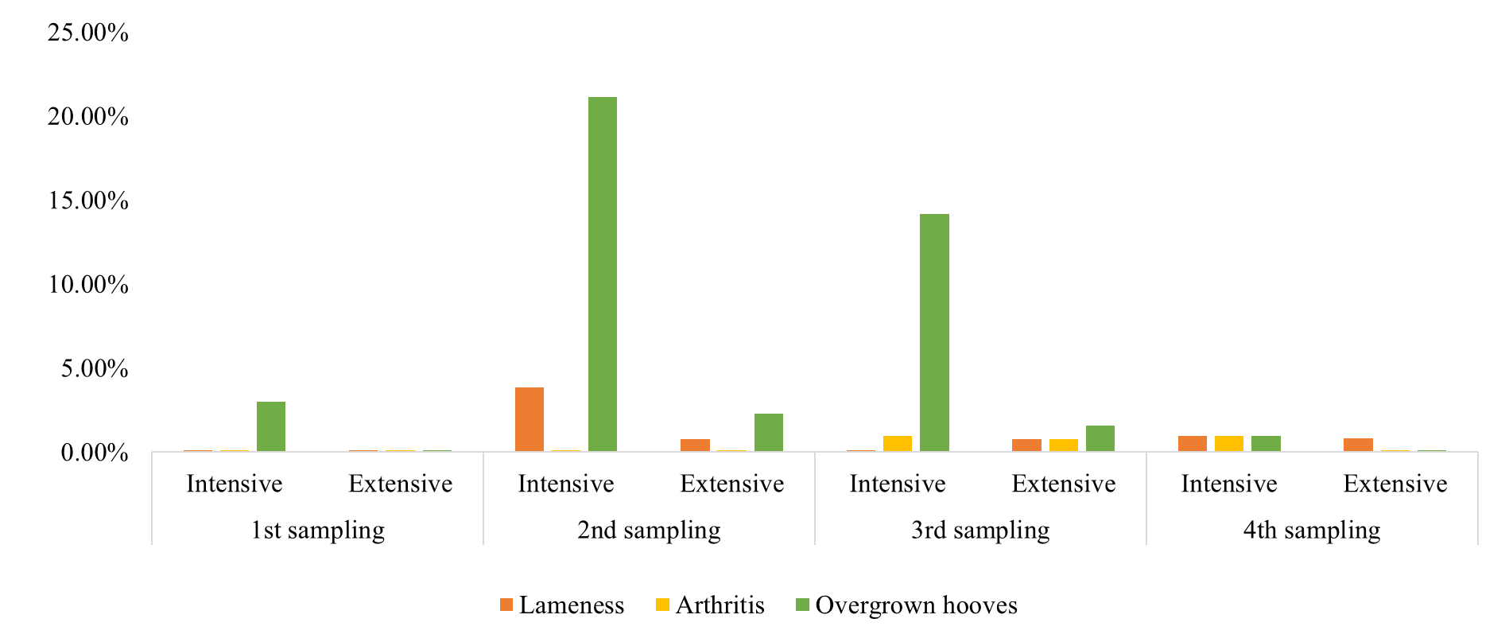
Results - Limbs
*p< 0.05 ***p< 0.001
***
***
*

Slide 11
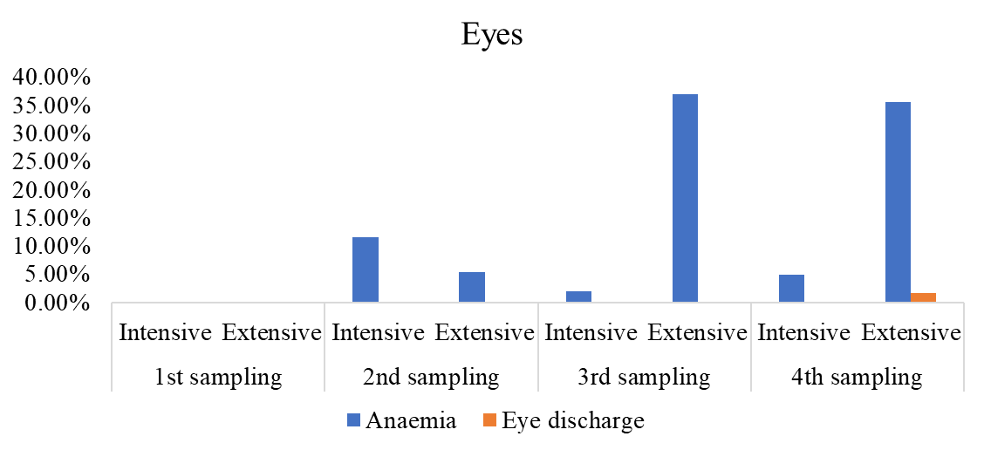
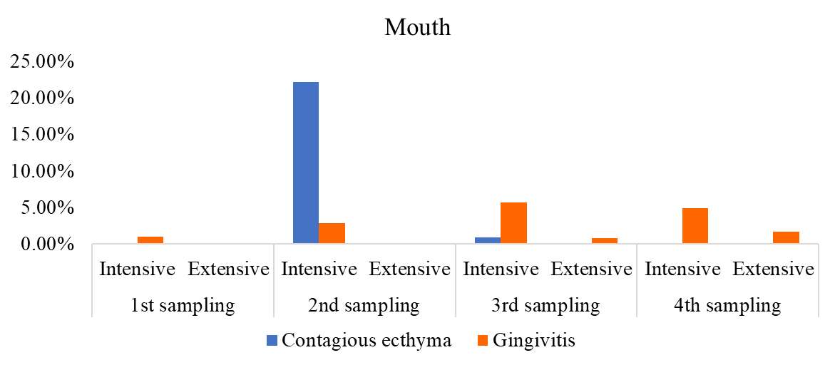
Results – Head 1
*p< 0.05 ***p< 0.001
***
***
***
*

Slide 12
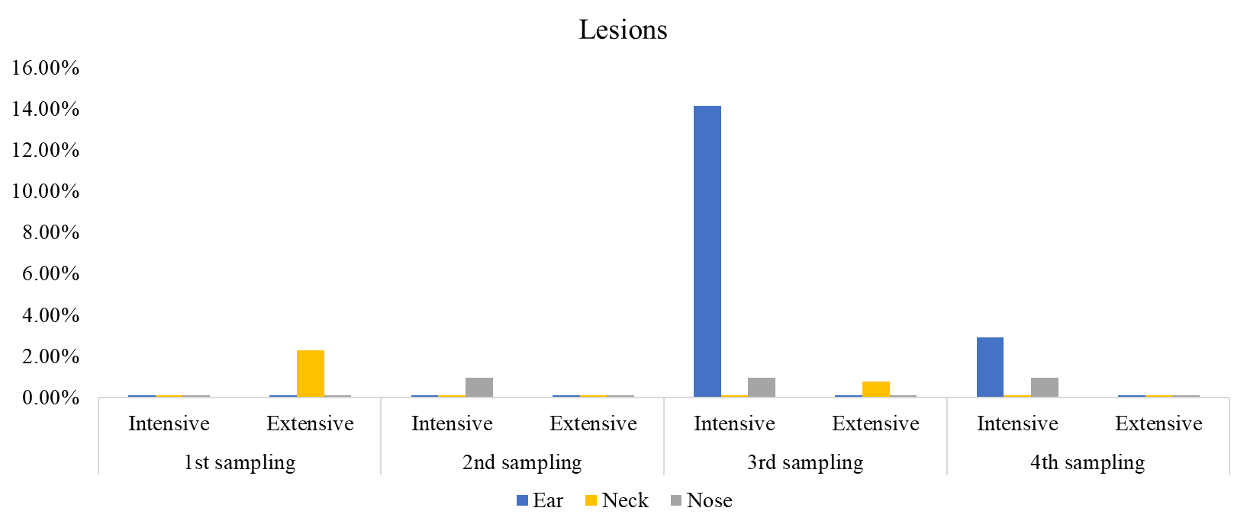
Results – Head 2
***p< 0.001
***

Slide 13
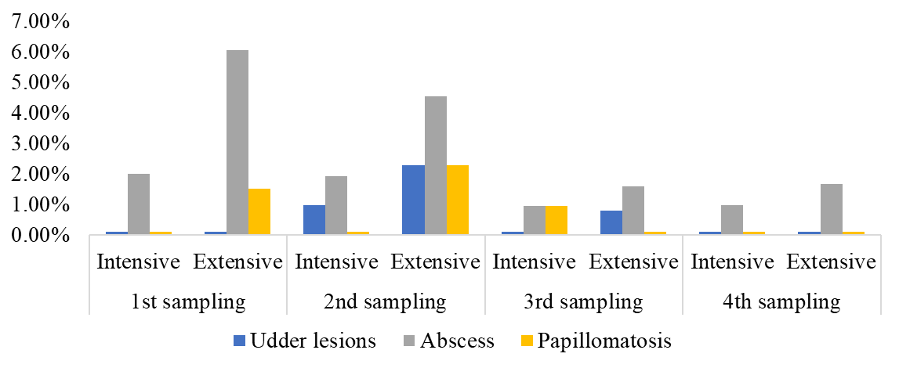
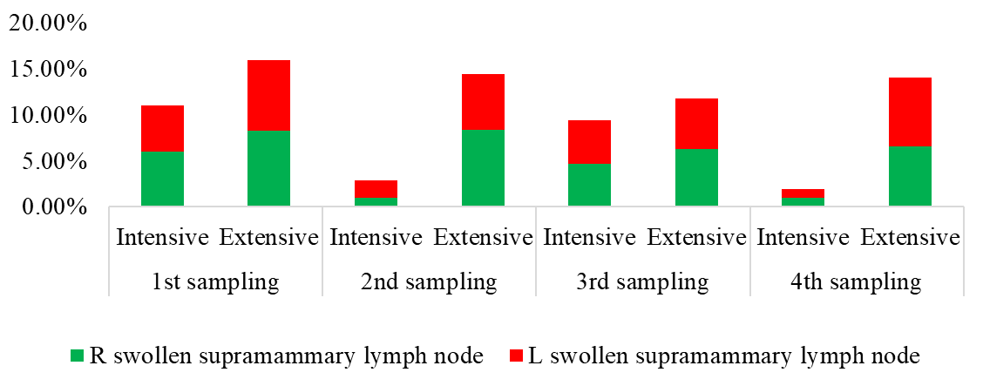
Results – Udder 1
*p< 0.05
*
*
*

Slide 14
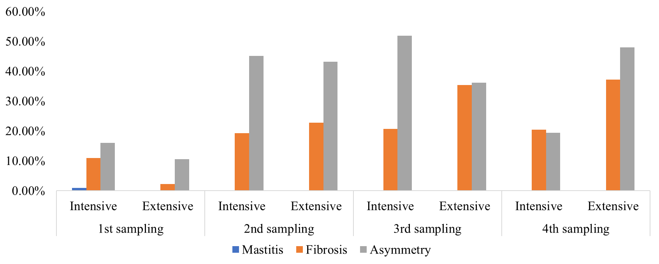
Results – Udder 2
*p< 0.05 **p< 0.01 ***p< 0.001
*
***
**
*
**

Slide 15
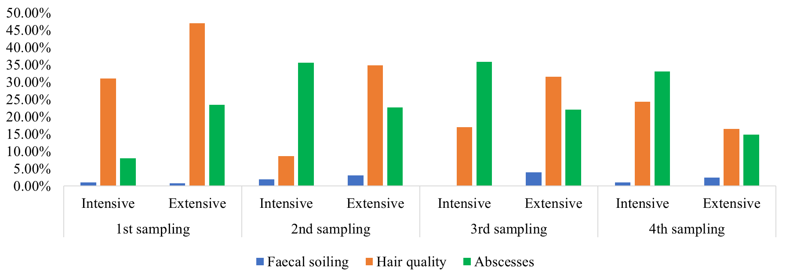
Results - Body
*p< 0.05 **p< 0.01 ***p< 0.001
*
*
***
*
*
**
**
*

Slide 16
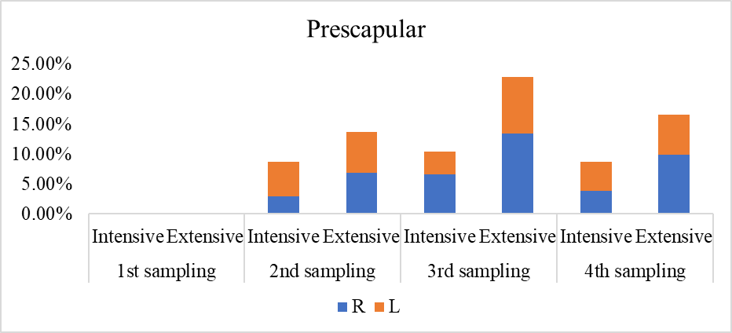
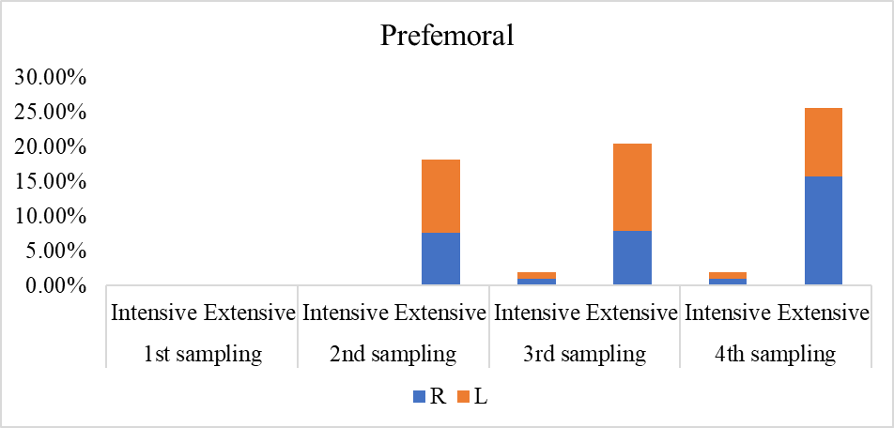
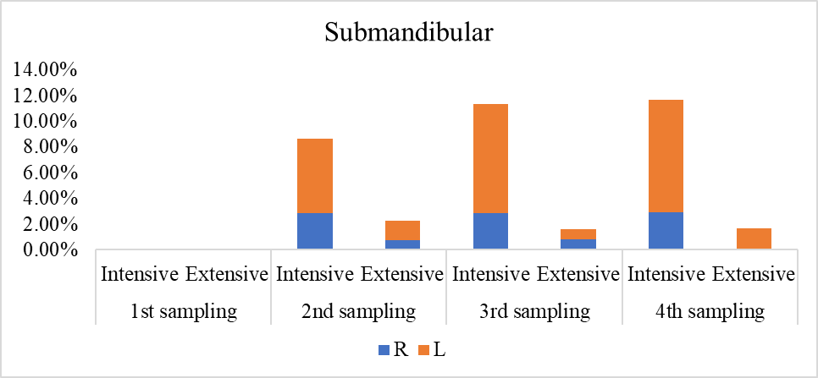
Results – Lymph nodes
**
**
**
***
*
**
*
**
*
*p< 0.05 **p< 0.01 ***p< 0.001

Slide 17
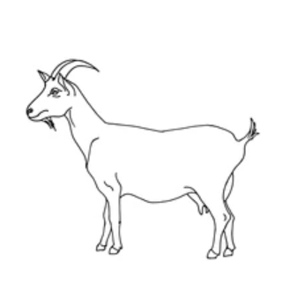
Conclusion
Intensively reared Skopelos goats
Extensively reared Skopelos goats
Poor hair quality
Anaemia
Gingivitis
Submandibular lymph nodes
Prescapular lymph nodes
Lameness
Overgrown hooves
Prefemoral lymph nodes

Slide 18
Conclusion
Both systems have intrinsic costs and benefits for the health and welfare of goats
Targeted modifications of husbandry and herd health management practices should be implemented based on evidence-based findings

Slide 19
Acknowledgments
This project has received funding from the European Union’s Horizon 2020 research and innovation programme under grant agreement No 101000216.

Slide 20
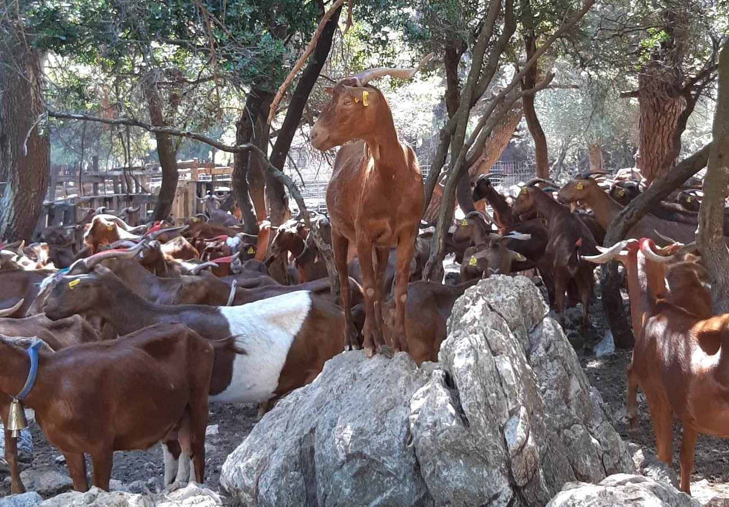
Thank you for your attention!

